Slide 1
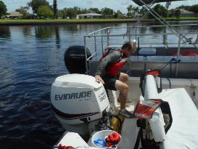
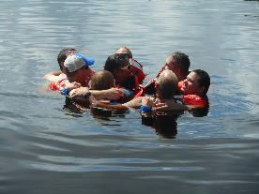
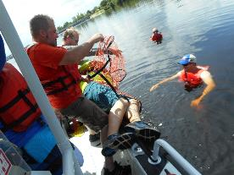
MOTORBOAT TRAINING, TESTING & LICENSING
Presenter:
Title: Emergency Procedures
Manual – TAB 7
Date:

Slide 2
EMERGENCY PROCEDURES
Objectives:
Recognize symptoms of persons in distress and persons drowning
Understand and be able to perform the rescue sequence
Know the methods of self rescue and be able to perform at least two of them
Learn how to rescue a victim back into the boat

Slide 3
1. Most boating fatalities involve capsizing or falls overboard, i.e., people end up in the water that were not planning on being there and were not wearing a PFD.
2. Vessels less than 16 feet account for most fatalities. Ironically, small vessels have less stringent equipment requirements.
3. Most drownings occur within ten feet of safety. Therefore, chances are that most rescues will be a simple reach or throw.

Slide 4
Priorities in rescue situations.
1. Self is most important. Do not do anything that will endanger yourself during a rescue attempt.
2. Your partner(s) are second in importance. Ensure that both you and your rescue partner(s) are safe during any rescue attempt.
3. The victim is least important. You and your rescue partner(s) should not do anything that will make yourselves become victim(s) during a rescue attempt.

Slide 5
Characteristics of a person in distress.
1. Can wave and yell for help.
2. Has not yet reached the panic stage.
Characteristics of a person drowning.
1. Cannot speak, consciously wave for help, or consciously grab rescue device.
2. Has reached the stage of total panic.
3. May have as little as 20 to 60 seconds before they go under; or may disappear immediately.
4. Appear to be doing a sideways breaststroke with arms raised above the head and moving down onto the water. The head is tilted way back and the mouth is wide open. May have the appearance of playing or splashing.
5. Will drown you if they can get close enough to you.

Slide 6
Rescue sequence.
A. Talk Try to talk the victim into self-rescue if the situation permits. Remember to maintain visual and verbal contact with the victim while using any rescue technique.
B. Reach Reach towards the victim with something that the victim can grab hold of and be pulled to safety.
1. Use pike pole, paddle, fishing pole, etc. to reach out to victim.
2. Place reach device in the victim’s hand or under their arm. A drowning victim cannot think rationally to reach out and grab hold of the item. If the device touches them, the victim will grab hold of it instinctively.

Slide 7
3. Be careful that the victim doesn’t pull in the rescuer. The rescuer should be prepared to let go of reach device if they are in danger of being pulled into the water with the victim.
4. Rescuer can extend an arm or leg to the victim, but be sure that the rescuer is firmly anchored to safety. This is a dangerous maneuver because the rescuer may not be able to let go if the victim is pulling the rescuer into the water.
C. Throw Throw an object that floats to the victim and that is attached to a line to pull the victim to safety.
1. Use the throwing technique when
conditions or time prevent a reach rescue.
2. Throw upstream or upwind so device
will float to victim.
3. Shout “rope” when throwing.

Slide 8
4. A throwable ring buoy with 90 feet of 3/8 “ or better polypropylene line attached.
a. Required by EM 385-1-1 on all Corps vessels.
b. A ring buoy is the best choice for a victim in the panic stage or unable to keep themselves afloat.
c. Rescuers must practice throwing ring buoy to maintain proficiency. Inexperienced rescuer may have trouble with throwing distance and accuracy.
5. Throw bag or heaving line.
a. These aids offer no flotation to the victim.
b. Inexperienced rescuers may find the throw bag or heaving line easier to use than a ring buoy.
c. These aids are good for use with victims able to float unassisted and not in the panic stage.
d. Throw bags or heaving lines must be thrown past the victim so they may grab the line and not the bag.
6. Other possible throwing items may include any type PFD, cooler, spare tire, or anything that floats.

Slide 9
D. Go Use a boat to go to the victim.
1. Approach victim into the wind or current for more positive control of your vessel.
2. Use reach and throw techniques when the vessel is close enough to the victim.
3. As your boat nears the victim, shut the engine off unless other hazards dictate otherwise (nearby dam, currents, high winds, etc.).
4. Go to the victim using in-water rescue techniques as a last resort.
a. Special notes.
1. In-water rescue is the most dangerous form of rescue that should only be attempted by individuals who have been trained, who consistently practice, and who are in adequate physical condition.
2. Cold water rescue (water temperature less than 70 degrees) requires the use of a cold-water survival suit.
3. Use in-water rescue as a last resort when all other methods have failed or are impossible.

Slide 10
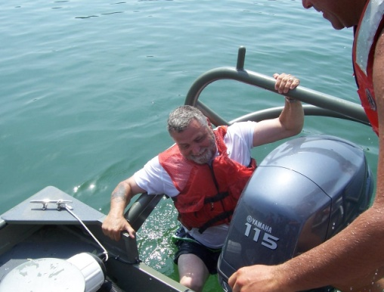
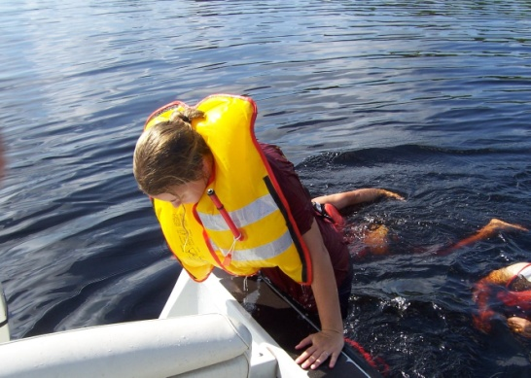
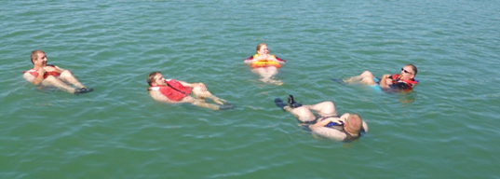
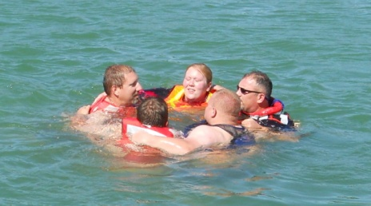
Self Rescue Techniques.
A. Chin-up bounce
B. Stirrup
C. Cavitation plate
D. Ladder
E. HELP – heat escape lessening posture
F. HUDDLE – two or more victims
*HELP and HUDDLE can increase survival as much as 4 times

Slide 11
Getting victims into the rescue boat.
A. Know your boat. Use the stern or as far astern as possible. Some boats will not safely allow an over-the-side retrieval.
B. Conscious victim with no major injury.
1. A ladder is the easiest and most effective means of boarding a boat. EM 385-1-1 requires Corps vessels to carry a boarding ladder.
2. A stirrup can be made by tying loop(s) in a line and fastening it to a cleat. Victim can then climb the loop(s) as a rope ladder.
3. Retrieval strap.
a. Put a loop of rope or webbing under the victim’s armpits.
b. May need two rescuers to lift the victim.
c. May need to use the bounce technique, pulling victim as high as possible on the second bounce into the boat.

Slide 12
Unconscious or weak victims can be rolled
aboard the vessel.
1. Secure the end of a rescue net or blanket by tying it to the
side of the boat or by standing on it.
2. Put the rest of the net/blanket in the water and cradle the
victim with it.
3. Rescuers pull up in unison, rolling the victim up and over the side of the boat.
4. Do not use this technique if the victim has suspected cervical injuries or other trauma.
Suspected spinal injuries.
1. Call EMS
2. While still in the water, keep head and neck aligned by placing one forearm on the victim’s sternum and the other on the victim’s spine
3. Support the victim’s head by cupping the chin and back of the skull with your hands
4. Move the victim only if a life threatening, immediate danger exists

Slide 13
Review:
What is the proper rescue procedure?
What are the four self-rescue techniques to get
back into a boat?
HELP is an acronym for what?
Explain the HUDDLE
What are the characteristics of a person drowning?
Who is top priority in a rescue attempt?
T/F – You should approach a drowning victim with
the wind to your back to get there faster.
T/F - Cold water rescues only happen when water
temperatures drop to 32 degrees or lower

